Slide 1
GEOG-G489/589 Python Programming
Instructor: Natasha MacBean
Functions and Classes for object oriented programming

Slide 2
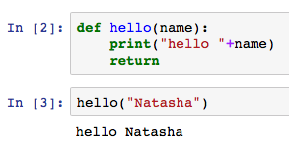
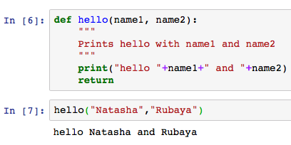
Simple functions → defined using “def”
You can use functions in your Jupyter Notebook but probably best to define all functions at the start of the script (after importing libraries)

Slide 3
Examples
Function for cleaning your data
Function for scaling your data
Function for processing one variable (say converting units of one variable)
Function for plotting a selection of plots

Slide 4
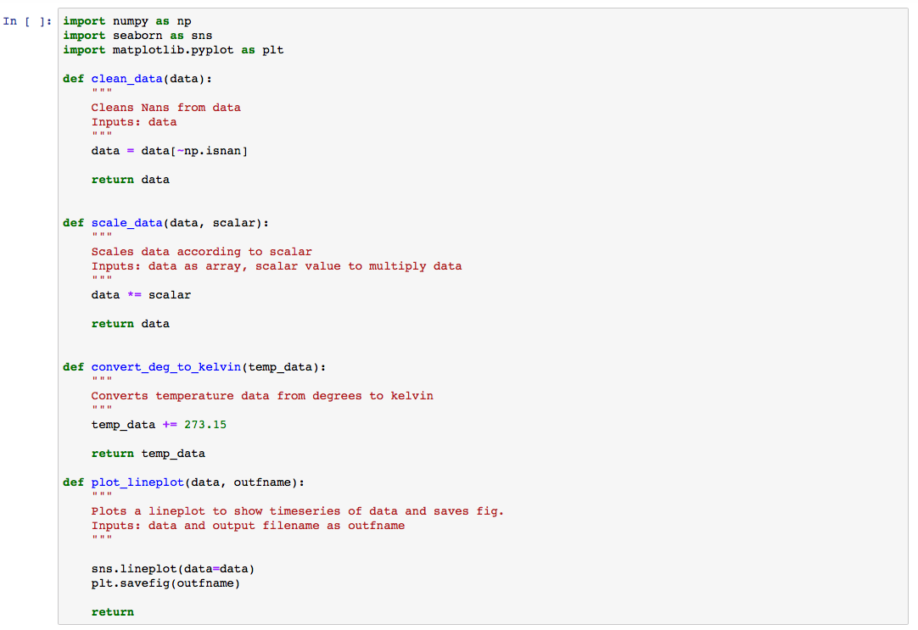
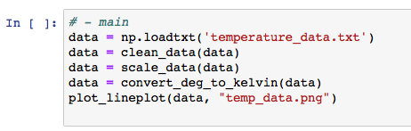
Examples

Slide 5
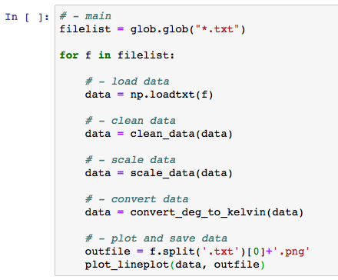
Makes processing a lot of data easier to read

Slide 6
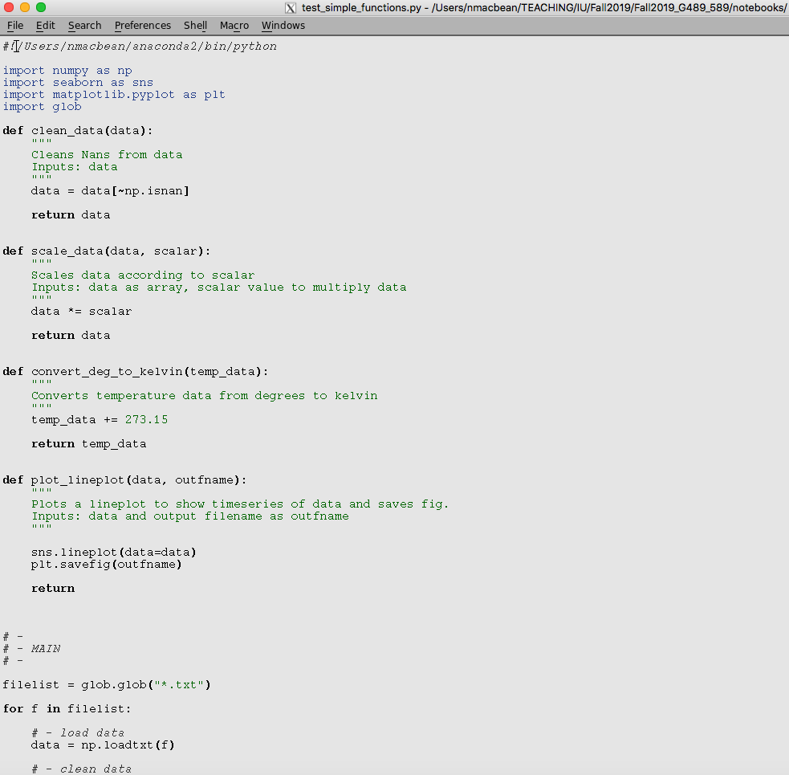
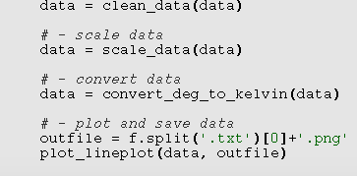
Python script (execute on unix command line)

Slide 7
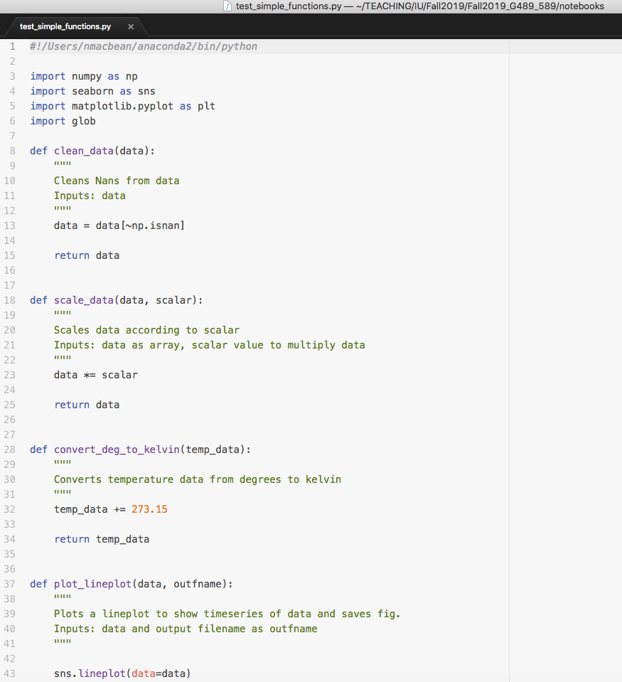
Nicer text editors (e.g. atom.io)

Slide 8
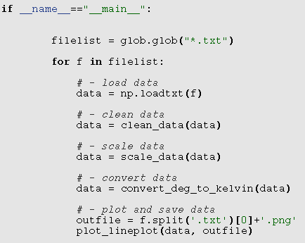
Standalone and importable script using: if __name__ == “__main__”:
https://www.afternerd.com/blog/python-__name__-__main__/

Slide 9
Classes for object oriented programming
Allows you to gather all commonly used functions with a particular purpose into one script:
Lots to learn about classes – read here: https://docs.python.org/3.7/tutorial/classes.html

Slide 10
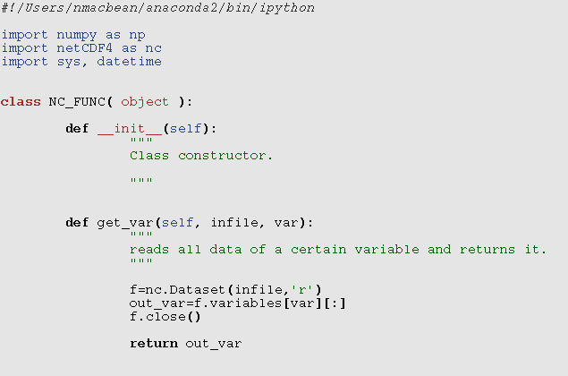
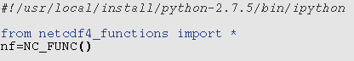
Classes examples

Slide 11
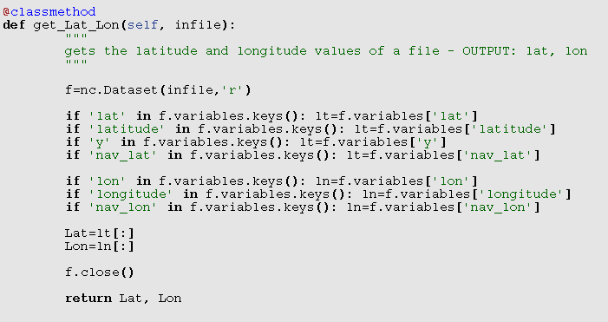
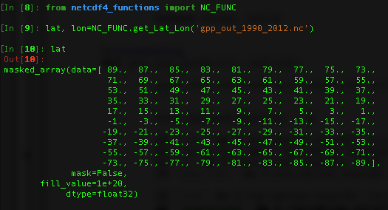
Alternative way of importing methods from classes
Defining the function as a “classmethod” effectively allows it to be used as a standalone method without calling an instance of the entire class

